Slide 1
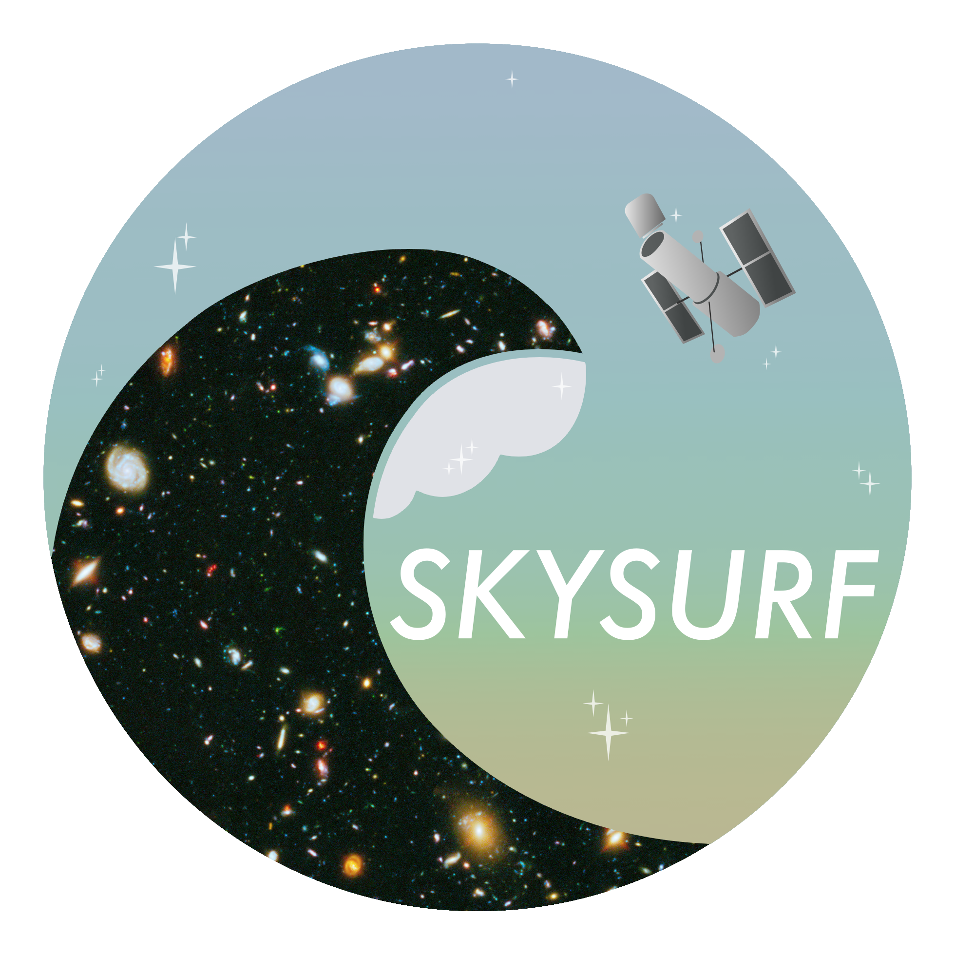
SKYSURF AWS Processing
Daniel Henningsen Mentors: Rogier Windhorst and Timothy Carleton

Slide 2
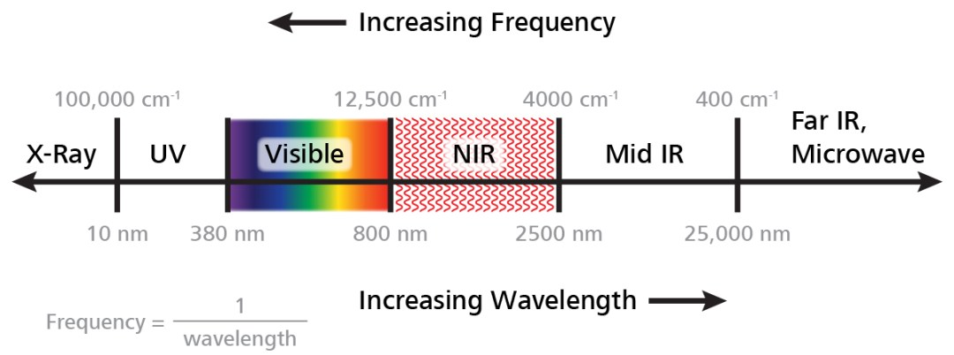
SKYSURF
Largest Hubble Space Telescope (HST) archive program to date.
Focused on classifying level of diffuse optical background in light UV to near-IR
Two sides of program:
All surface background brightness measurement.
Low-surface brightness object counts.
Daniel Henningsen djhenni1@asu.edu
Image Credit: Metrohm AG

Slide 3
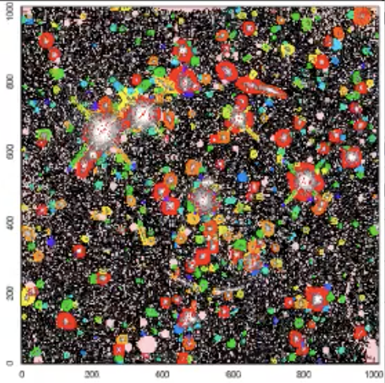
ProFound
Measures the background of HST images.
Masks bright objects (image) and calculates the background background from the image by looking at brightness of remaining pixels.
Daniel Henningsen djhenni1@asu.edu

Slide 4
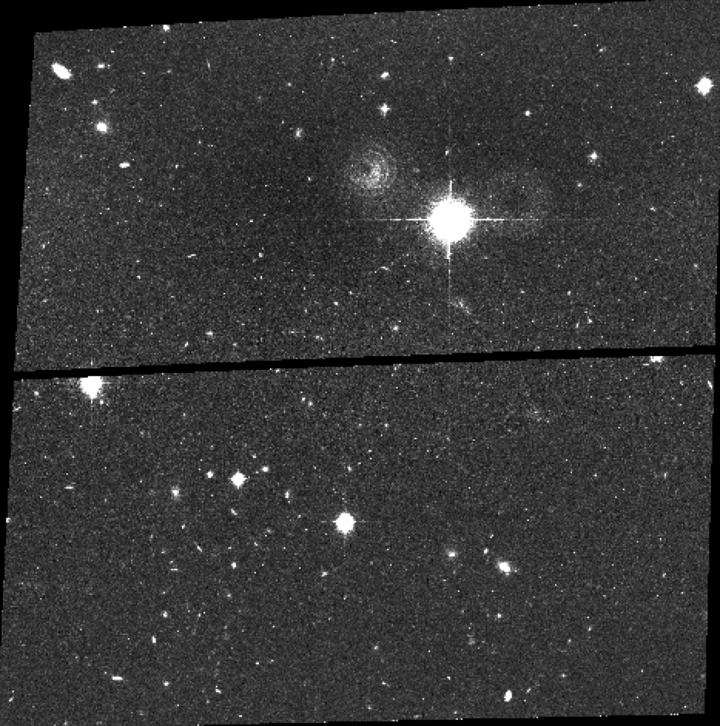
AstroDrizzle
Drizzles together images from same HST visit to create a longer exposure and deeper image to detect fainter objects.
After drizzling and taking ProFound’s sky brightness values into account, Source Extractor will be able to count low-surface brightness objects.
Daniel Henningsen djhenni1@asu.edu

Slide 5

Amazon Web Services
Needed a way to run ProFound and AstroDrizzle on over 57,000 datasets.
Turned to AWS cloud computing to solve this issue.
Needed to figure out how to minimize the cost of renting and running an AWS cloud computer(s).
Image Credit: Amazon Web Services
Daniel Henningsen djhenni1@asu.edu

Slide 6
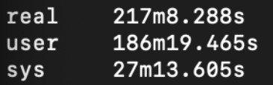
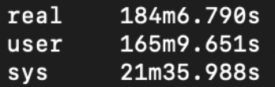
Speed Tests
Tested two AWS setups:
16 GB RAM
32 GB RAM
Could run two images at a time by processing them in parallel on the 32 GB computer vs renting two 16 GB computers.
16 GB RAM Computer
32 GB RAM Computer
Daniel Henningsen djhenni1@asu.edu

Slide 7
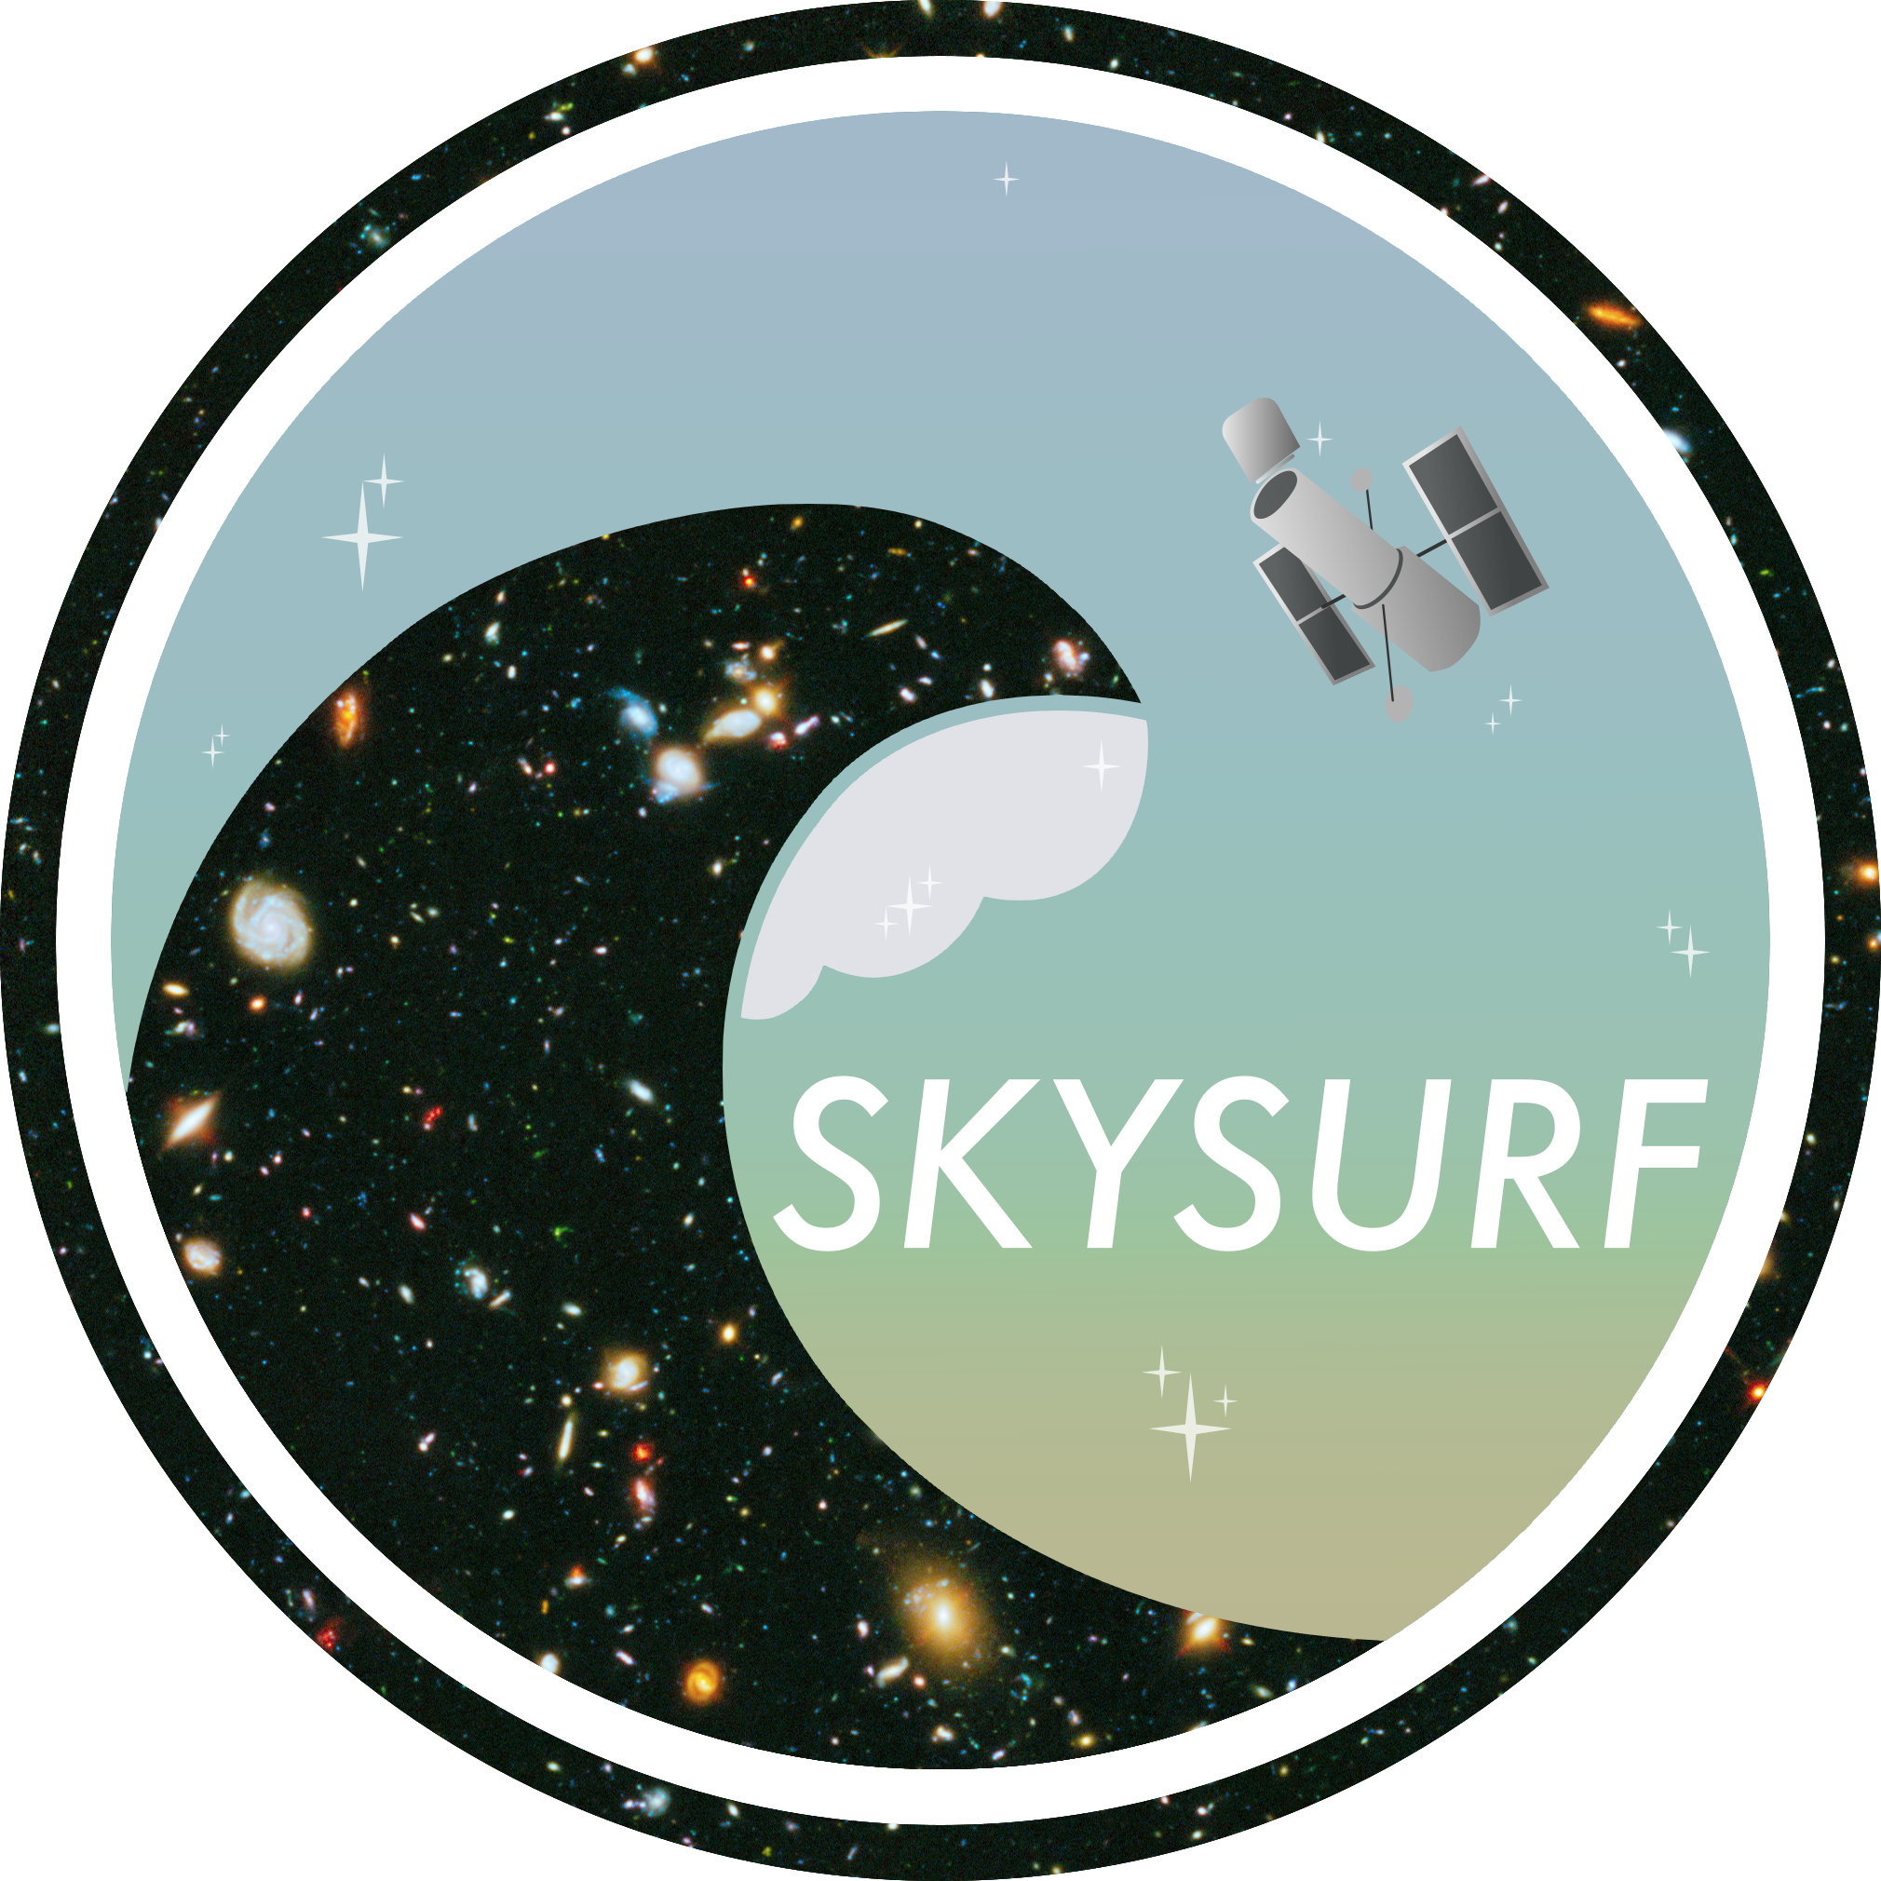

Results & Next Steps
Mass ProFound processing took 50 days to complete.
AWS turned out to be a great solution for processing the large amount of data we had to work with. In addition to running ProFound.
Mass AstroDrizzle processing begun in early April and will take a similar amount of time to finish.
Daniel Henningsen
Arizona State University
Contact: djhenni1@asu.edu

